Slide 1
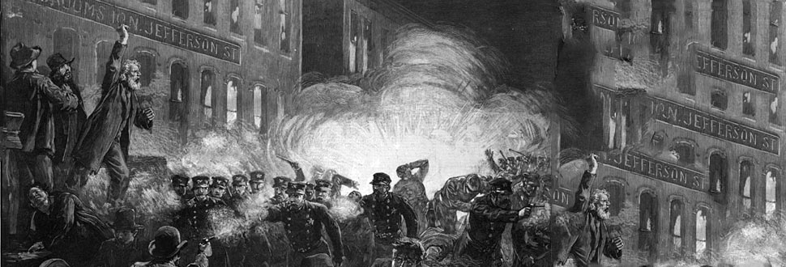
Historical Foundation of Unions
Student’s Name
Institution

Slide 2
Introduction
Trade union have existed for many centuries
They are as old as the country
They started in 1700s
Largely influenced by expansion of economic activities
Population increase caused workforce increase
The demand for workforce also sprung
Notes:
Trade or labor unions in the United States are believed to be as old as the country because they started in the 1700s right after the country attained independence. However, they were largely influenced by the increased population, which consequently influenced the workforce population. As the country’s economy increased and expanded, the demand for workforce also increased. This, in turn, created a natural demand for workers. Consequently, there was need to protect workers from exploitation.

Slide 3
Labor Unions in 1790s
U.S. labor movement started in 1792
The Association of Shoemakers in Philadelphia
Started after the revolution
The first union to be established in the U.S
After that, unions grew in size and power (Cole et al., 2011)
Order of the Knights of St. Crispin
Notes:
Historians have established that U.S. trade or labor unions have existed for many centuries. The first trade union was established in 1792 and other unions followed right after that. The Association of Shoemakers that was established in Philadelphia became the ground root for trade and labor movements in the United States. As Cole et al. (2011) explain, many other unions grew right after 1800. The Order of the Knights of St. Crispin, founded in 1869 was a major trade union that represented shoe industry in the 1800s. Unions grew with more power and size as the wave expanded across the United States.

Slide 4
Labor Movement and Gender Equality
Early 1800s saw an increased workforce
Social challenges emerged
Gender quality became an issue
Women were paid less than their male counterparts
Unions played a central role in advancing women rights
1834 First turnout of mill girls in Lowell (AFL-CIO)
Notes:
At the beginning of 1800, trade unions that emerged advocated for women rights. Women employees were working in the same firms where men were working and yet they were paid less. The earliest organized efforts, as trade unions, to advocate for women’s rights came as a result of the gender discrimination in pay, were Mill girls in Lowell. As such, women who worked in mills such as Lowell in Massachusetts became the first batch of young women to protest wage cuts for women.

Slide 5
Continuation: Gender Equality
1843-Lowell female Labor Reform Association began petition
1871-Mary Harris began working as a labor organizer (AFL-CIO)
1903-Women’s Trade Union league formed
1909-Uprising of more than 20,000 women in New York
1974-Coalition of Labor Union Women formed
Notes:
Labor unions in the United States has been central to gender equality issues. The early associations that were formed from 1800s aimed at advocating for better pay and fair treatment of women in the workforce. Apart from the 1834 first turnout of the mill girls in Lowell, other movements emerged in attempt to improve the labor rights of women in the United States. Some of the labor associations that emerged are highlighted in this slide. As shown here, the struggle for women’s rights in the workforce extended for more than a century. However, achievements gained are as a result of trade unions.

Slide 6
Labor Movement and Immigrants
Search for opportunities influenced immigration
People came from Europe and Asia
In search of good jobs (Cole et al., 2011)
1877-Railroad workers hold national uprising
1909-Steelworkers organize strike (AFL-CIO)
1912-Bread and Roses strike
1973-Labor Council for LAA founded
Notes:
Labor movement in the United States has been closely tied to immigration. The immigration trend in the early 1800s to the United States was influenced by search for job opportunities. Immigrants who came to the United States in the 1800s were looking for jobs. Availability of jobs in the U.S. made it possible for them to arrive. However, they also sought to advocate for their rights as immigrant workers. Different attempts were made to create an organized labor market beginning with the 1877 uprising of the Irish railroad workers.

Slide 7
Workplace Safety
Early labor unions were concerned about workplace safety
Their establishment was as a response to workplace conditions (Kimeldorf & Stepan-Norris, 1992)
1909-female shirtwaist uprising
1911-Triangle shirtwaist factory incident
1970-Occupation Safety and Health Act enacted (AFL-CIO)
Notes:
Several changes were made in response to workplace safety in the United States. However, this came after series of events and accidents that informed workers to organize strikes and uprisings protesting the working conditions. As shown in this slide, some of the uprisings in the early 1900s created a framework towards creating an organized workforce associations. For instance, the 1909 uprising comprised of more than 20,000 female shirtwaist makers demonstrated against sweatshop conditions (AFL-CIO). It took several decades, but in 1970, Occupation Safety and Health Act was passed to protect the safety of workers.

Slide 8
Labor Unions
The demand for workers was high in 1800s
National Labor Union was founded after Civil War
It was short lived
Order of the Knights followed but also failed in 1886
American Federal of Labor was founded in 1886
Notes:
The journey towards creating a stable labor union in the United States was marred by series of challenges that prevented the firs unions from surviving the century. The first national union, National Labor Union was founded after Civil War, but it was short-lived. The Order of the Knights of St. Crispin emerged in 1869, but was also faced with challenges after the public turned against it in 1886 following the death of an officer. The American Federal of Labor, which has remained the foundation the current unions in the United States was founded in 1886 by Samuel Gompers to represent the skilled American workers.

Slide 9
Conclusion
Labor unions have transformed over the years
Early unions were formed in response to:
-Gender equality issues
-Workplace safety conditions
Most of the early unions failed
However, American Federal Labor union survived
Has remained the foundation of labor union
Notes:
In conclusion, these findings have shown that the early labor unions were formed to address specific challenges that were facing the workers. This ranges from poor working conditions to gender equality issues. However, most of the unions formed in the early years faced challenges due to lack of national figure. This explains why the American Federal Labor formed in 1886 has remained to be the core foundation of American labor movement as we know it today.

Slide 10
References
AFL-CIO. Our Labor History Timeline (Online). https://aflcio.org/about-us/history
Cole, P. F., Megivern, L., & Hilgert, J. (2011). American Labor in US History Textbooks: How Labor's Story Is Distorted in High School History Textbooks. Albert Shanker Institute.
Kimeldorf, H., & Stepan-Norris, J. (1992). Historical studies of labor movements in the United States. Annual Review of Sociology, 18(1), 495-517.

